Slide 1
Content-Based Video Retrieval System
Presented by:
Edmund Liang
CSE 8337: Information Retrieval

Slide 2
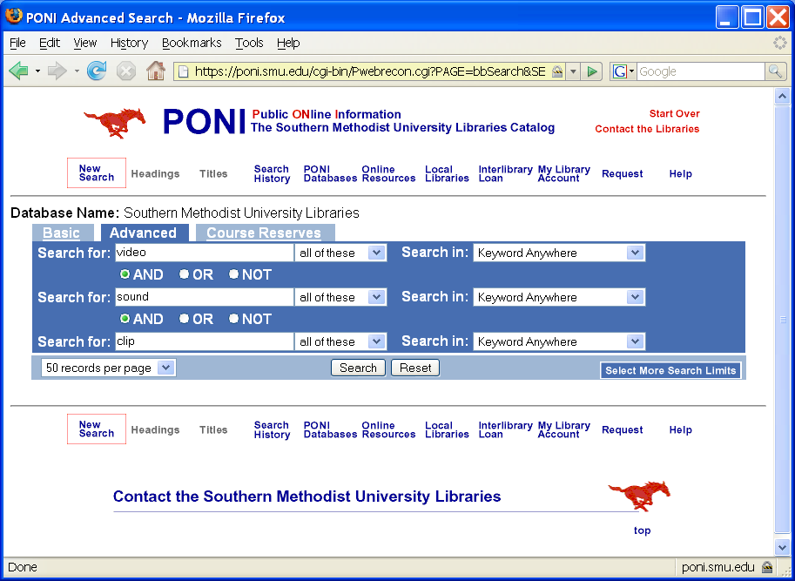
Introduction
Traditional Library search method

Slide 3
Introduction (cont.)
Other search engines still using description search method.
Current image search method: by description.

Slide 4
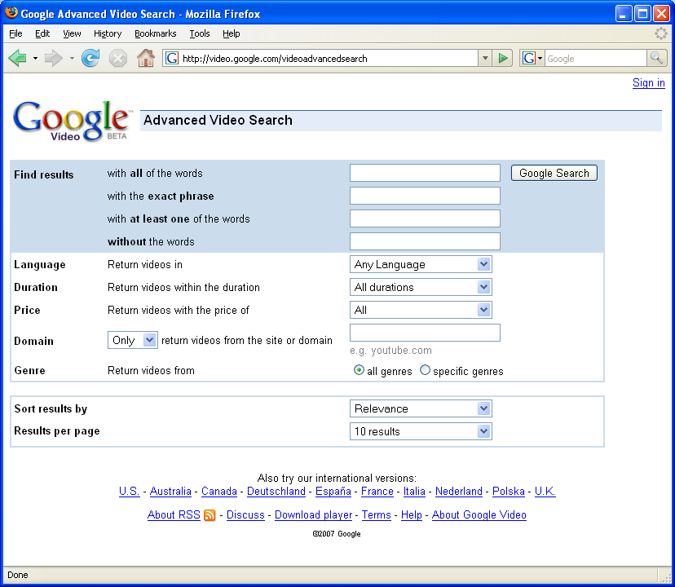
Introduction (cont.)
Sample of Google Video Search:

Slide 5
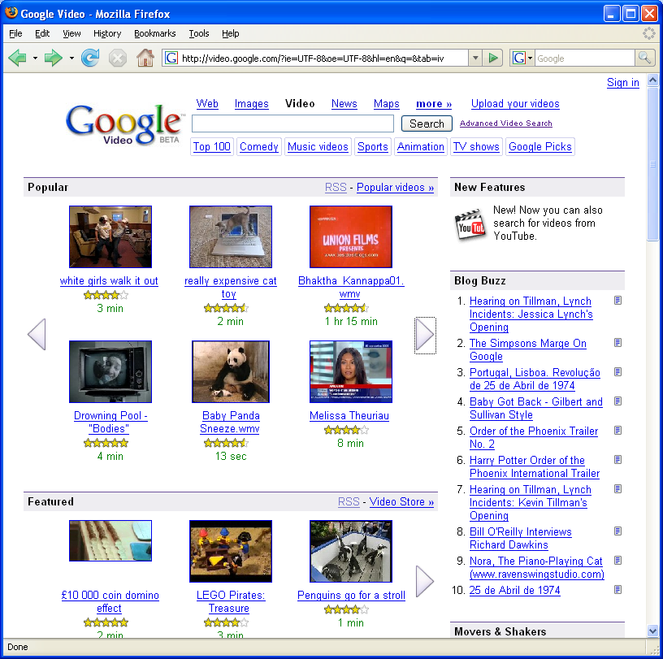
Introduction (cont.)
Google Video Archive selections:

Slide 6
Introduction (cont.)
Picture is worth a thousand words.
More than words can express.
Growing number video clips on MySpace and YouTube, there is a need for a video search engine.

Slide 7
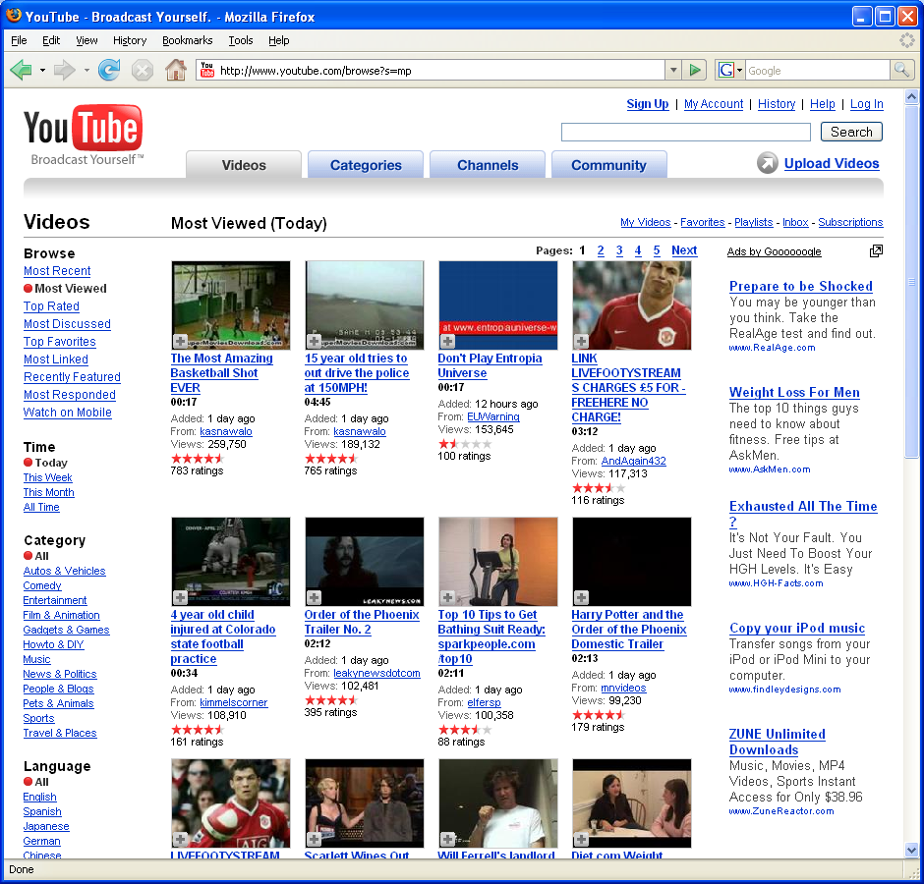
Introduction (cont.)
Sample YouTube Video page:

Slide 8
Introduction (cont.)
Therefore, we need a better search technique – Content-Based Video Retrieval System (CBVR).

Slide 9
Introduction (cont.)
What good is video retrieval?
  Historical Achieve
  Forensic documents
  Fingerprint & DNA matching
  Security usage

Slide 10
Overview (cont.)
CBVR has two Approaches:
  Attribute based
  Object based
CBVR can be done by:
  Color
  Texture
  Shape
  Spatial relationship
  Semantic primitives
  Browsing
  Objective Attribute
  Subjective Attribute
  Motion
  Text & domain concepts

Slide 11
Overview (cont.)
CBVR has two phases:
  Database Population phase
    Video shot boundary detection
    Key Frames selection
    Feature extraction
  Video Retrieval phase
    Similarity measure

Slide 12
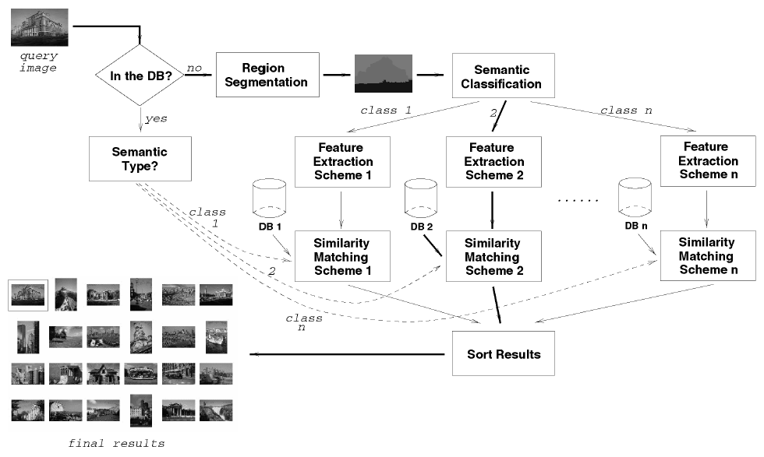
Overview (cont.)
How CBVR works:
[Wang, Li, Wiederhold, 2001]

Slide 13
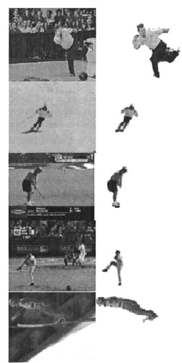
Database Population Phase
Here are the three major procedures:
  Shot boundary detection – partition, segments
[Luo, Hwang, Wu, 2004]

Slide 14
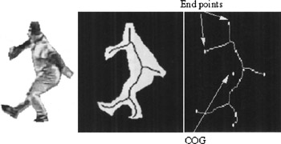
Database Population Phase (cont)
  Key frames selection – select characteristics
  Extracting low-level spatial features like color, texture, shape, etc.
[Luo, Hwang, Wu, 2004]

Slide 15
Database Population Phase (cont.)
Video is complex data type – audio & video
Audio can be handled by query by humming.
Voice recognition system using Patricia-like tree to construct all possible substrings of a sentence.
Audio is categorized by: speech, music, and sound.
Audio retrieval methods: Hidden Markov Model, Boolean Search with multi-query using Fuzzy Logic.

Slide 16
Database Population Phase (cont)
Most simple database storage: description of video as index along with the video.
Human effort is involved in this case.
We are searching for automatic video indexing and digital image storage method – Latent Semantic Indexing (LSI)

Slide 17
Database Population Phase (cont.)
LSI is using vector space model – low rank approximation of vector space represent image document collection.
Original matrix is replaced by an as close as possible matrix, where its column space is only the subspace of the original matrix column space.
By reducing the rank of the matrix, noises (duplicate frames) are reduce to improve storage and retrieval performance.
Term indexing is referred to the process of assigning terms to the content of the video.

Slide 18
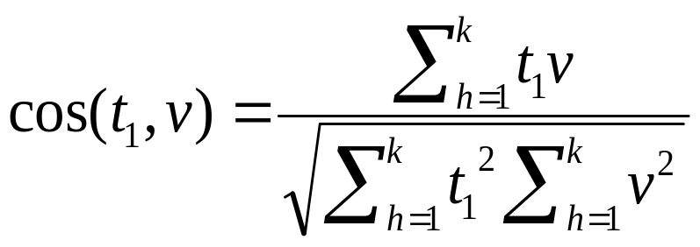
Database Population Phase (cont.)
Closest terms in the database is returned based on the similarity measure between the query images and the resulting ones.
Cosine similarity measure is used in the vector space model.
Cosine similarity measure on Term-by-video matrix:

Slide 19
Database Population Phase (cont.)
Enterprise database like Oracle introduces new object type: ORDImage, which contains four different visual attributes: global color, local color, texture and shape.
ORDImageIndex provides multidimensional index structure to speed up stored feature vectors.

Slide 20
Database Population Phase (cont.)
Oracle example of joining two images of Picture1 and Picture2:
  CREATE TABLE Picture1(
  author VARCHAR2(30),
  description VARCHAR2(200),
  photo1 ORDSYS.ORDImage,
  photo1_sig ORDSYS.ORDImageSignature
  );
  CREATE TABLE Picture2(
  mydescription VARCHAR2(200),
  photo2 ORDSYS.ORDImage,
  photo2_sig ORDSYS.ORDImageSignature
  );
  SELECT p1.description, p2.mydescription
  FROM Picture p1, Picture p2,
  WHERE
  ORDSYS.IMGSimilar(p1.photo1_sig, p2.photo2_sig,
  ‘color=”0,6” texture=”0,2” shape=”0,1”
  location=”0,1”’, 20)=1;
  Note: Weighted sum of the distance of the visual attributes is less than or equal to the threshold, the image is matched.

Slide 21
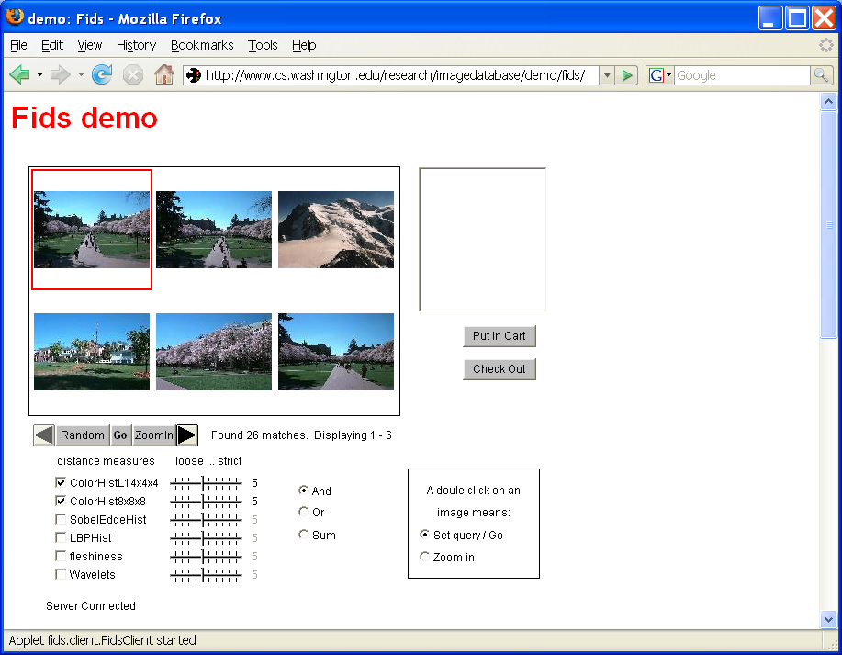
Image Retrieval Phase
Query by example (QBE)
  Allow to select sample image to search.
[Wang, Li, Wiederhold, 2001]

Slide 22
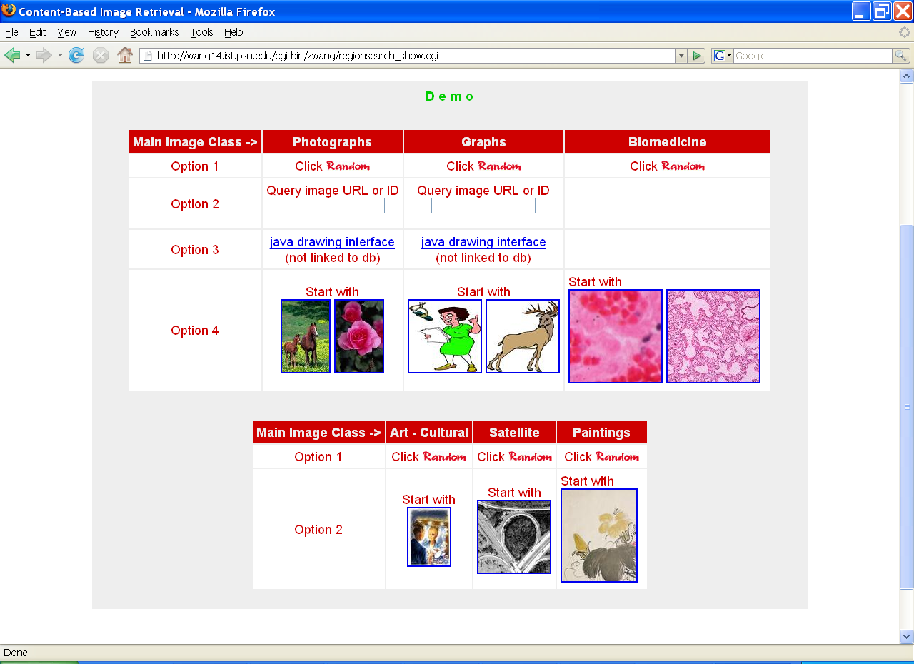
Image Retrieval Phase (cont.)
Yet Another CBVR Application Interface
[Li, Shapiro 2004]

Slide 23
Image Retrieval Phase (cont.)
Query by color anglogram
  Histogram intersection measures is a fairly standard metric to analyze histogram base on features.
  Image is divided into 5 sub-images, upper right, upper left, lower right, lower left, and the center image.

Slide 24

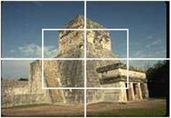
Image Retrieval Phase (cont.)
Query by color anglogram (cont.)
  Convert RGB to HSV [wikipedia]
  Global and sub-image histogram forms LSI matrix.
[Zhao & Grosky 2002]

Slide 25



Image Retrieval Phase (cont)
Sample results:
Ancient Towers
Ancient Columns
Horses Figure
[Zhao & Grosky 2002]

Slide 26
Image Retrieval Phase (cont.)
Retrieve by shape anglogram
  Each image is divided into 256 block.
  Each block is approximated with hue and saturated value.
  Corresponding feature points are mapped perceptually base on the saturated value.
  Feature histogram is obtained by measure the largest angle of the nearest feature points.

Slide 27
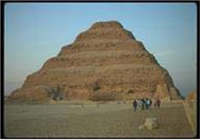

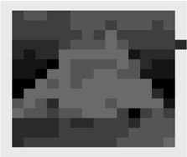
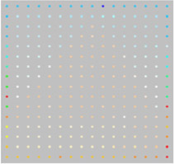
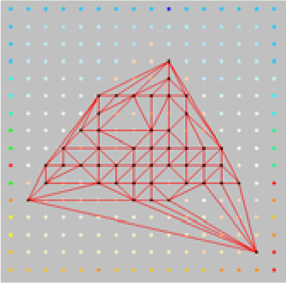
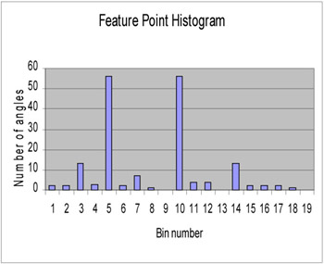
Image Retrieval Phase (cont.)
Query by shape anglogram (cont): Demo
[Zhao & Grosky 2002]

Slide 28
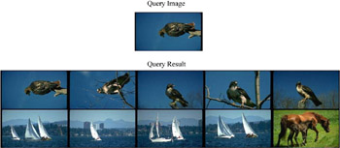
Image Retrieval Phase (cont.)
Query by shape anglogram sample output:
[Zhao & Grosky 2002]

Slide 29
Image Retrieval Phase (cont.)
Query by color and other category selection combination.
  Use training dataset: sky, sun, land, water, boat, grass, horse, rhino, bird, human, pyramid, column, tower, sphinx, and snow.
  Sun(5%), grass (15%), Sky(20%) combine with the LSI matrix to return better results.

Slide 30
Future Works
Handle multi-layer images
Include human-intractable relevance retrieval feedback system.
Eliminate bias objects but not affecting the performance.

Slide 31
Summary
Content-Based Video Retrieval system contains two phases:
  Database population phase
    Shot boundary detection
    Key frames selection
    Extract low-level features
  Image retrieval phase
    Query by example
    Query by color anglogram
    Query by shape anglogram
    Query by color anglogram and category bit.

Slide 32
Conclusion
Content-based Video Retrieval system is not a sound system.
Video stream will become the main stream in the years to come.
Better off if we had a efficient CBVR search engine ready.
Still many area needs to be improved.

Slide 33
The End
Thank you.

